Slide 1
Evaluating automatic text simplification performance on classic literature
Brandon Wilde & Melissa Lopez

Slide 2
Automatic Text Simplification (ATS)
Goal: Reduce the complexity of a sentence while retaining its meaning
How?¹
Split or merge sentences
Insert, reorder, or delete words (e.g., removing complex clauses, passive to active voice)
Substitute words (e.g., use less complex synonyms)
Why?²
Support those with low literacy levels (e.g., people with limited education, nonnative readers, people with disabilities)
Improve reading comprehension => improve communication => improve quality of life
¹ “Linguistically-based comparison of different approaches to building corpora for text simplification: A case study on italian.” (2022). Dominique Brunato, Felice Dell’Orletta, and Giulia Venturi.
² ”Automatic Text Simplification for Social Good: Progress and Challenges.” (2021). Sanja Stajner.
Notes:
Melissa

Slide 3
Our Project
Build a parallel corpus of literary texts and evaluate ATS performance
Questions:
Do state-of-the art ATS systems perform well on this data given that most ATS corpora are for informational texts³?
Can you control the amount of simplification while retaining quality?
How do automated metrics correlate with human judgment?
³ ”Automatic Text Simplification for Social Good: Progress and Challenges.” (2021). Sanja Stajner.
Notes:
Melissa

Slide 4
Corpus of Classic Literature Sentence Simplifications
50 simplified sentences from abridged texts⁴
Emily Bronte | Wuthering Heights
Jane Austen | Mansfield Park
George Eliot | Daniel Deronda
Laurence Sterne | Tristram Shandy
W.M. Thackeray | Vanity Fair
Elizabeth Gaskell | North and South
Charlotte Bronte | Shirley
Anthony Trollope | The Way We Live Now
Anthony Trollope | Can You Forgive Her?
Charles Dickens | Bleak House
100 sentences we simplified
Fyodor Dostoevsky | Crime and Punishment
James Joyce | Ulysses
Jonathan Swift | A Modest Proposal
Robert Louis Stevenson | The Strange Case of Dr. Jekyll and Mr. Hyde
Charles Dickens | Great Expectations
Jane Austen | Pride and Prejudice
Mary Shelley | Frankenstein
F. Scott Fitzgerald | The Great Gatsby
Lewis Carroll | Alice’s Adventures in Wonderland
Arthur Conan Doyle | Sherlock Holmes
Oscar Wilde | The Picture of Dorian Gray
Franz Kafka | Metamorphosis
Original FKGL: 12.4
Simplified FKGL: 5.6
⁴ All original texts accessed via Project Gutenberg. Abridgments written by Emma Laybourn and made freely available to the public at http://englishliteratureebooks.com/.
Notes:
Brandon

Slide 5
ATS Systems
ACCESS⁵
(AudienCe-CEntric Sentence Simplification)
Controllable ATS System based on control tokens
Trained on Wikilarge simplifications corpus (300k)
MUSS⁶
(Multilingual Unsupervised Sentence Simplification)
Unsupervised version of ACCESS - trained on paraphrases mined from the web (1.2M)
MUSS+
MUSS with additional training on Wikilarge simplifications corpus
TS Attributes: |  | Expressed via ratios of:
Sentence Compression | → | Number of Characters
Paraphrasing | → | Levenshtein Similarity
Lexical Complexity | → | Q3 Word Rank
Syntactic Complexity | → | Dependency Tree Depth
Source: | <NbChars 0.3> <LevSim 0.4> He settled in Lon- don , devoting himself chiefly to practical teaching .
Target: | He teaches in London .
⁵ ”Controllable Sentence Simplification.” (2019) Louis Martin, Benoît Sagot, Eric de la Clergerie, and Antoine Bordes. arXiv preprint arXiv:1910.02677.
⁶ “MUSS: Multilingual Unsupervised Sentence Simplification by Mining Paraphrases” (2020) Louis Martin, Angela Fan, Éric de la Clergerie, Antoine Bordes, and Benoît Sagot. arXiv preprint arXiv:2005.00352

Slide 6
Evaluation (Performed with EASSE⁷)
Model control tokens configured to match reference corpus
Automated Metrics
Reference-dependent
SARI
BLEU
BERTScore (Prec, Rec, F1)
Token F1
Reference-independent
Flesch-Kincaid Grade Level
Compression Ratio
Sentence Splits
Levenshtein Similarity
Exact Copies
Additions Proportion
Deletions Proportion
Lexical Complexity Score
Human evaluation on 30-example subset
Grammaticality
Simplicity
Adequacy
Evaluated at corpus level for model comparison
Evaluated at sentence level to assess metric correlations
⁷ “EASSE: Easier Automatic Sentence Simplification Evaluation” (2019) Fernando Alva-Manchego, Louis Martin, Carolina Scarton, and Lucia Specia. In Proceedings of the 2019 Conference on Empirical Methods in Natural Language Processing and the 9th International Joint Conference on Natural Language Processing (EMNLP-IJCNLP): System Demonstrations.
Notes:
Brandon

Slide 7
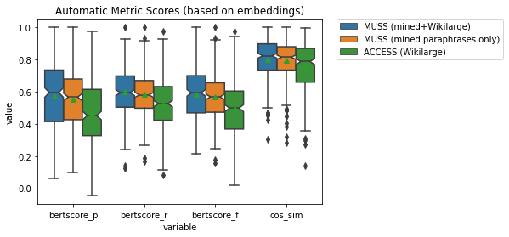
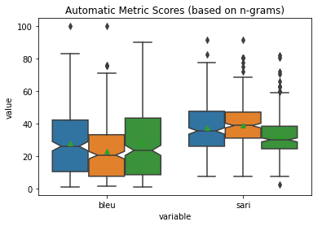
Automated Metrics
Mean FKGL
Original | 12.4
Human | 5.6
MUSS+ | 5.5
MUSS | 6.9
ACCESS | 7.1

Slide 8
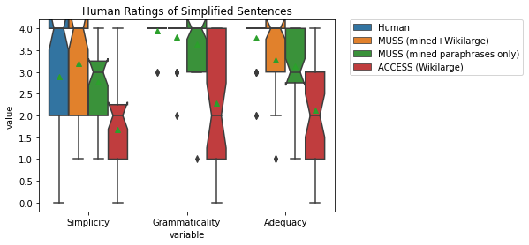
Human Ratings
Notes:
Melissa

Slide 9
Examples
COMPLEX | His many legs, pitifully thin compared with the size of the rest of him, waved about helplessly as he looked.
HUMAN | His many thin legs moved around helplessly as he looked.
ACCESS | His many legs, pitifully, compared with the size of the rest of him.
MUSS | His many thin legs, smaller than his body size, waved helplessly as he looked.
MUSS+ | His many legs were very thin. They waved about helplessly as he looked.

Slide 10
Conclusion
Some basic answers from the current project:
The best-performing ATS system was comparable to human references and to previous MUSS evaluation on Wikilarge data
Controlling MUSS (specifically, reducing compression ratio) resulted in more simplified results without a significant sacrifice in adequacy
BERTScore showed the strongest correlation with human ratings
…leading to more questions:
How can we understand the practical value of controllability better?
Are generic human references and automated metrics sufficient for training and evaluating a controllable system?
Notes:
Melissa

Slide 11
Thank you!

Slide 12
References
Fernando Alva-Manchego, Louis Martin, Carolina Scarton, and Lucia Specia. 2019. EASSE: Easier automatic sentence simplification evaluation. In Proceedings of the 2019 Conference on Empirical Methods in Natural Language Processing and the 9th International Joint Conference on Natural Language Processing (EMNLP-IJCNLP): System Demonstrations, pages 49–54, Hong Kong, China. Association for Computational Linguistics.
Dominique Brunato, Felice Dell’Orletta, and Giulia Venturi. 2022. Linguistically-based comparison of different approaches to building corpora for text simplification: A case study on italian. Frontiers in Psychology, 13.
Louis Martin, Angela Fan, Éric de la Clergerie, Antoine Bordes, and Benoît Sagot. 2020. Muss: multilingual unsupervised sentence simplification by mining paraphrases. arXiv preprint arXiv:2005.00352
Louis Martin, Benoît Sagot, Eric de la Clergerie, and Antoine Bordes. 2019. Controllable sentence simplification. arXiv preprint arXiv:1910.02677.
Sanja Stajner. 2021. Automatic Text Simplification for Social Good: Progress and Challenges. In Findings of the Association for Computational Linguistics: ACL-IJCNLP 2021, pages 2637–2652, Online. Association for Computational Linguistics.
Notes:
Melissa

